Slide 1
Deep Learning Demystified

Slide 2
TL;DR
Deep learning isn’t magic.
But it is very good at finding patterns.
Notes:
You

Slide 3
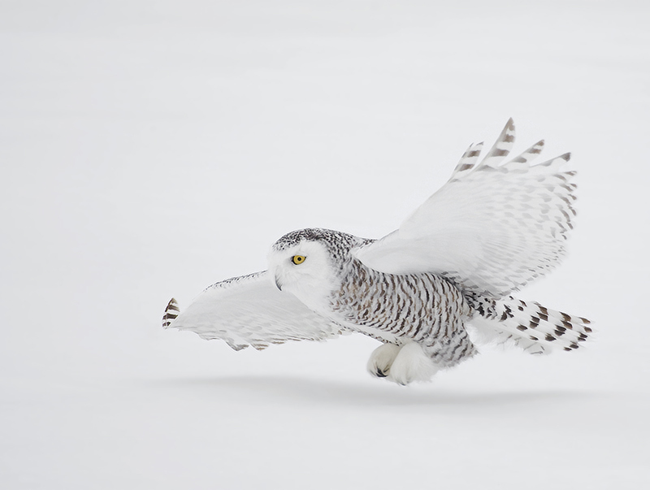
The brain and deep learning
Creative Commons 3

Slide 4
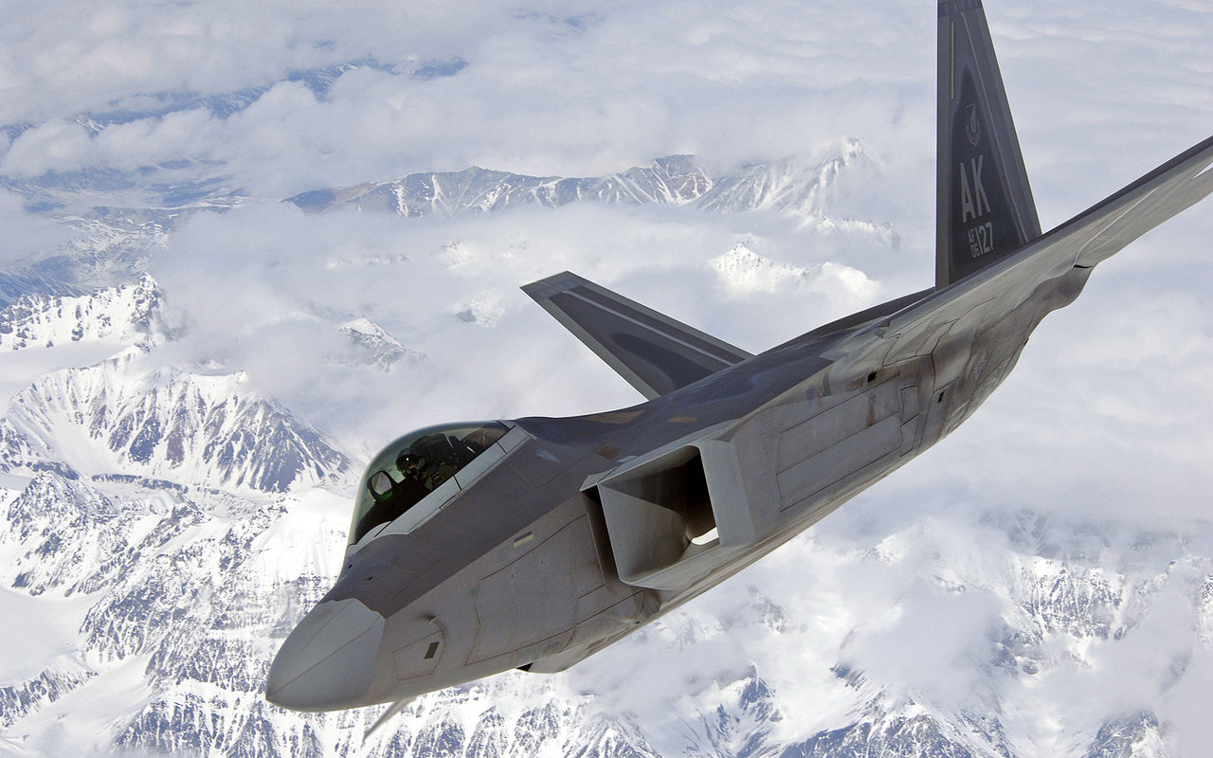
The brain and deep learning
Creative Commons 3
David Hemmings
public domain

Slide 5
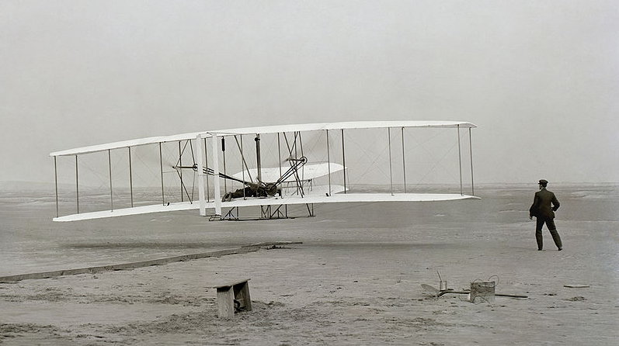
public domain

Slide 6
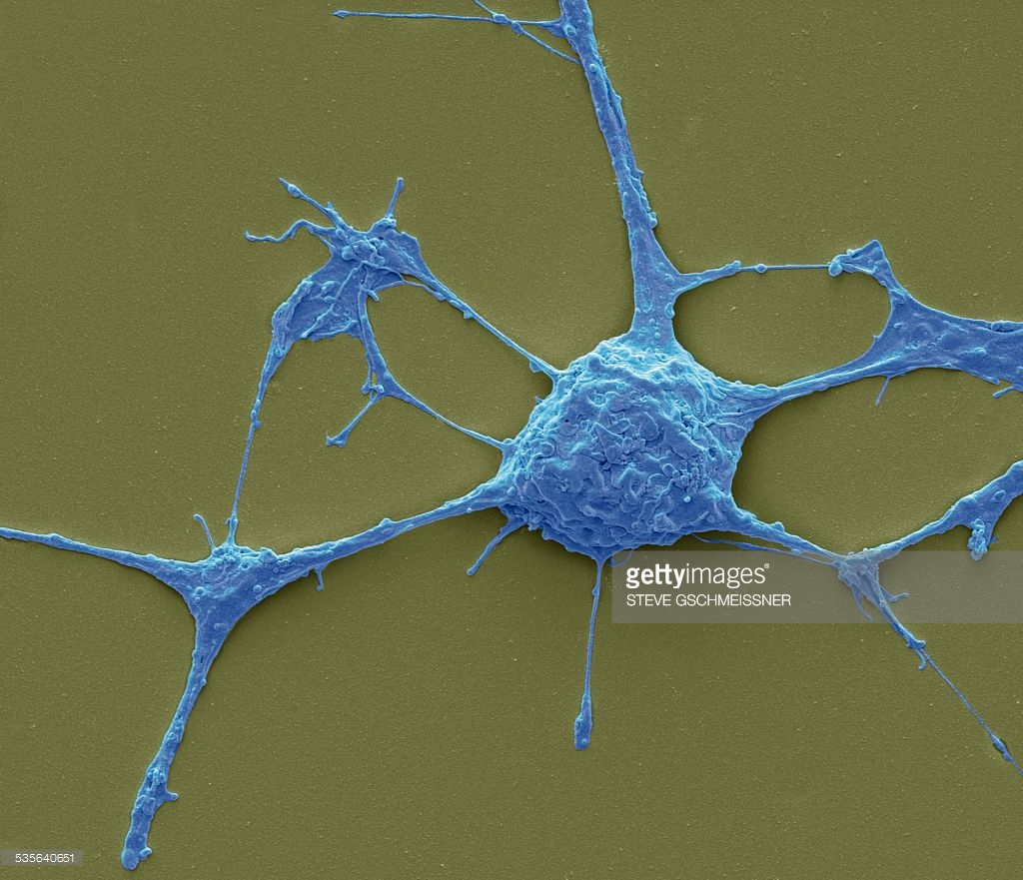
neuron

Slide 7
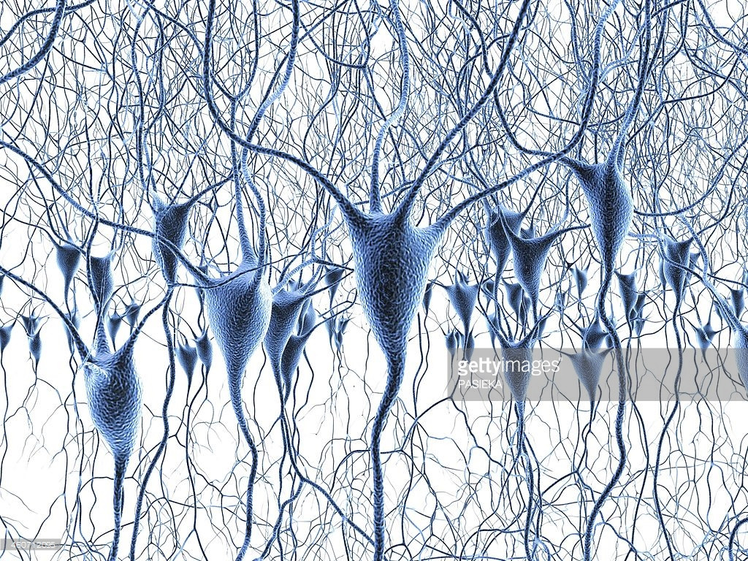
neural network

Slide 8
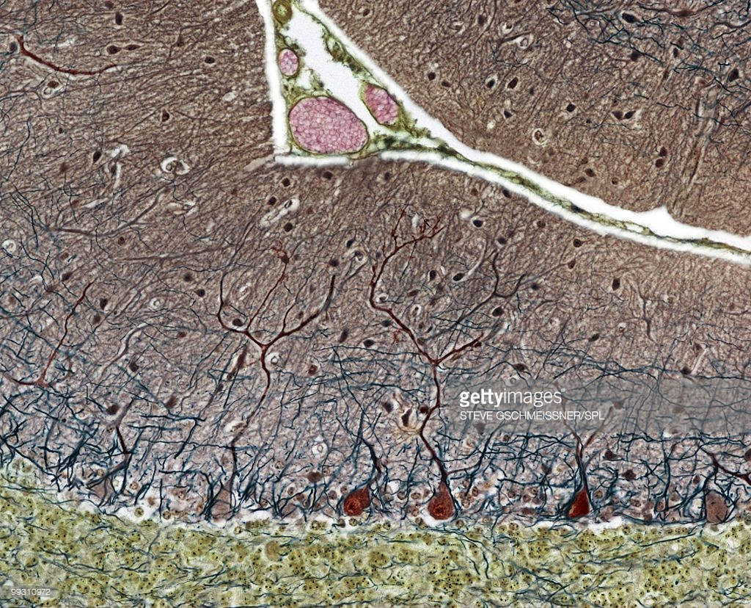
neural network

Slide 9
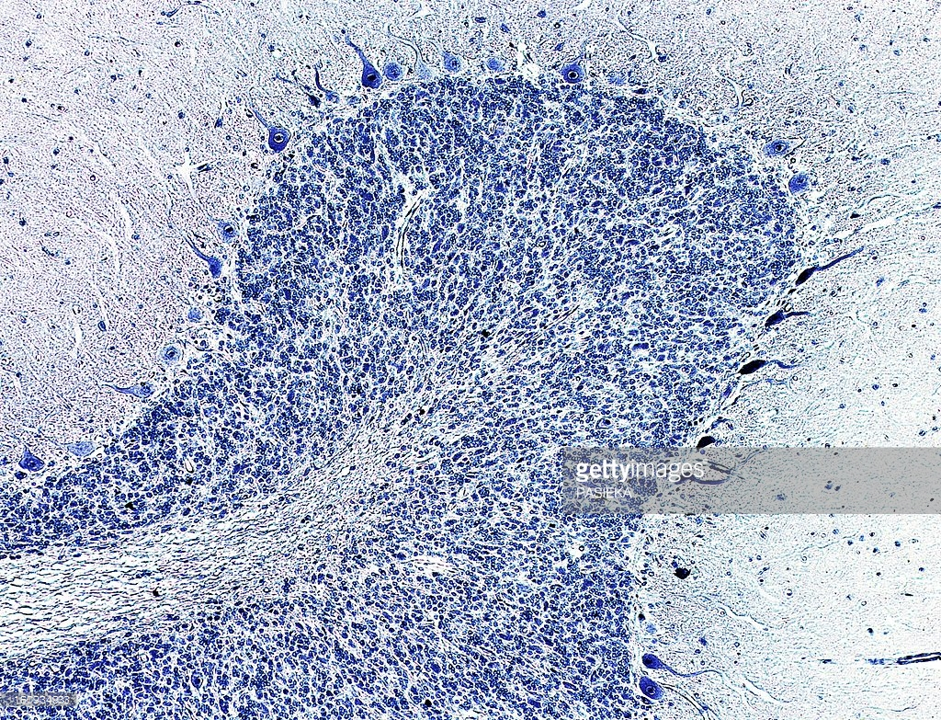
neural network

Slide 10
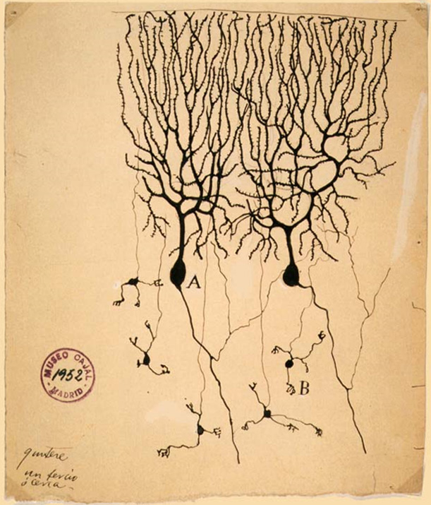
Neurons
Drawing of
Purkinje cells (A) and
granule cells (B) from pigeon cerebellum by
Santiago Ramón y Cajal,
1899; Instituto Cajal,
Madrid, Spain
Public domain

Slide 12
axon
soma
dendrites

Slide 13
axon
soma
dendrites

Slide 14
Soma adds dendrite activity together and passes it to axon.
+

Slide 15
More dendrite activity makes more axon activity
+

Slide 16
+

Slide 17
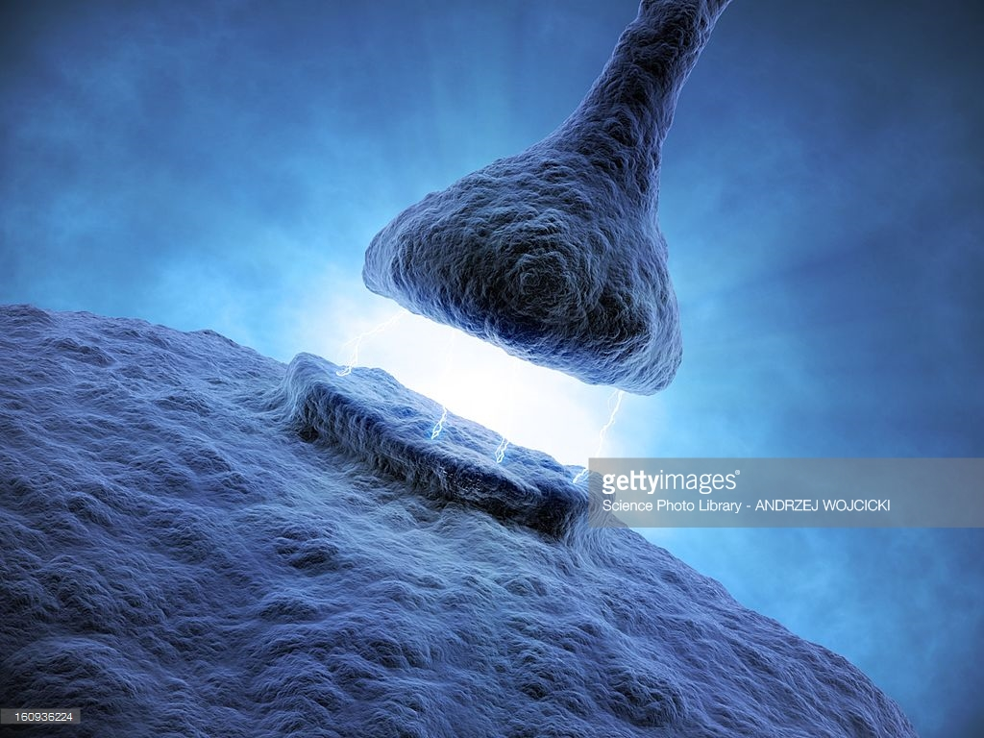
Synapse
Connection between axon of one neuron and dendrites of another
synapse

Slide 18
Synapse
Connection between axon of one neuron and dendrites of another

Slide 19
Synapse
Connection between axon of one neuron and dendrites of another

Slide 21
Axons can connect to dendrites strongly, weakly, or somewhere in between.

Slide 22
Medium connection (.6)

Slide 23
Strong connection (1.0)

Slide 24
Weak connection (.2)
No connection is a 0.

Slide 25
Lots of axons connect with the dendrites of one neuron.
Each has its own connection strength.

Slide 27
.5
.8
.3
.2
.9

Slide 28
.5
.8
.3
.2
.9

Slide 31
ACE
A
B
C
D
E

Slide 33
eyeball
eye
sun
ball
glasses

Slide 34
sunglasses
eyeball
eye
sun
ball
glasses

Slide 35
sunglasses
eyeball
eyeglasses
eye
sun
ball
glasses

Slide 36
The guy at the shawarma place
Sometimes he works mornings, sometimes evenings
am
am
pm
pm
am
am
pm
pm

Slide 37
This neural network captures the patterns in his schedule.
am
am
pm
pm
am
am
pm
pm

Slide 38
Training
How do we learn this?
am
am
pm
pm
1
0
0
1
0
1
1
0
am
am
pm
pm

Slide 39
Initialize
Start random
am
am
pm
pm
.3
.8
.9
.9
.6
.2
.1
.4
am
am
pm
pm

Slide 40
Gather data
am
am
pm
pm
.3
.8
.9
.9
.6
.2
.1
.4
am
am
am
pm
pm
pm

Slide 41
Activate each of the neurons
am
am
(.3+.1)/2=.2
pm
pm
.3
.8
.9
.9
.6
.2
.1
.4
am
am
pm
pm

Slide 42
Activate each of the neurons
am
am
.2
pm
pm
(.8+.4)/2=.6
.3
.8
.9
.9
.6
.2
.1
.4
am
am
pm
pm

Slide 43
Error
Calculate how bad the best fit neuron is.
If it’s a perfect fit, there is no need to update the weights.
If the best fit is bad, the weights need a lot of work.
am
am
.2
pm
pm
.6
Error=1-.6
=.4
.3
.8
.9
.9
.6
.2
.1
.4
am
am
pm
pm

Slide 44
Gradient descent
For each weight, adjust it up and down a bit and see how the error changes.
am
am
.2
pm
pm
.6
Error=.4
.3
.8
.9
.9
.6
.2
.1
.4
am
am
pm
pm

Slide 45
Gradient descent
For each weight, adjust it up and down a bit and see how the error changes.
error
weight

Slide 46
Gradient descent
For each weight, adjust it up and down a bit and see how the error changes.
error
weight

Slide 47
Backpropagation
Adjust all the weights
am
am
.2
pm
pm
.6
adjustment = error * gradient * delta
.3
.8
.9
.9
.6
.2
.1
.4
am
am
pm
pm

Slide 48
Backpropagation
Adjust all the weights
am
am
.2
pm
pm
.6
adjustment = error * gradient * delta
.3
.9
.9
.9
.6
.2
.1
.4
am
am
pm
pm

Slide 49
Backpropagation
Adjust all the weights
am
am
.2
pm
pm
.6
adjustment = error * gradient * delta
.3
.9
.9
.8
.6
.2
.1
.4
am
am
pm
pm

Slide 50
Backpropagation
Adjust all the weights
am
am
.2
pm
pm
.6
adjustment = error * gradient * delta
.3
.9
.9
.8
.6
.1
.1
.4
am
am
pm
pm

Slide 51
Backpropagation
Adjust all the weights
am
am
.2
pm
pm
.6
adjustment = error * gradient * delta
.3
.9
.9
.8
.6
.1
.1
.5
am
am
pm
pm

Slide 52
Backpropagation
Adjust the weights
am
am
.2
pm
pm
(.9 + .5)/2=.7
adjustment = error * gradient * delta
.3
.9
.9
.8
.6
.1
.1
.5
am
am
pm
pm

Slide 53
Backpropagation
The error is now a little lower.
am
am
.2
pm
pm
.7
error=1-.7
=.3
.3
.9
.9
.8
.6
.1
.1
.5
am
am
pm
pm

Slide 54
Iterate
Repeat this process until the weights stop changing.
am
am
pm
pm
.2
.9
1
.8
.7
.1
0
.5
am
am
am
pm
pm
pm

Slide 55
Iterate
Repeat this process until the weights stop changing.
am
am
pm
pm
.1
.9
1
.8
.8
.1
0
.5
am
am
am
pm
pm
pm

Slide 56
Iterate
Repeat this process until the weights stop changing.
am
am
pm
pm
.1
1
1
.8
.8
.0
0
.6
am
am
am
pm
pm
pm

Slide 57
Iterate
Repeat this process until the weights stop changing.
am
am
pm
pm
.1
1
1
.7
.8
0
0
.7
am
am
am
pm
pm
pm

Slide 58
Iterate
Repeat this process until the weights stop changing.
am
am
pm
pm
.1
1
1
.6
.8
0
0
.8
am
am
am
pm
pm
pm

Slide 59
Iterate
Repeat this process until the weights stop changing.
am
am
pm
pm
0
1
1
0
1
0
0
1
am
am
pm
pm

Slide 60
Each node represents a pattern, a combination of the neurons on the previous layer.
first layer
inputs

Slide 61
Deep network
third layer
If a network has more than three layers, it’s deep.
Some 12 or more.
second
layer
first layer
inputs

Slide 62
Deep network
…
Patterns get more complex as the number of layers goes up.
…
evasive
answer
antique
finish
altered
states
…
answer
antique
altered
astern
…
ant
ted
st
ern
qu
…
a
b
c
d
e

Slide 63
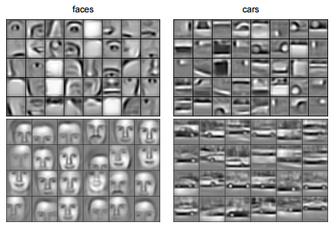
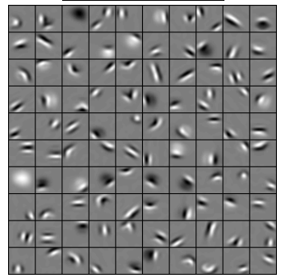
Convolutional Deep Belief Networks for Scalable Unsupervised Learning of Hierarchical Representations Honglak Lee, Roger Grosse, Rajesh Ranganath, Andrew Y. Ng

Slide 64
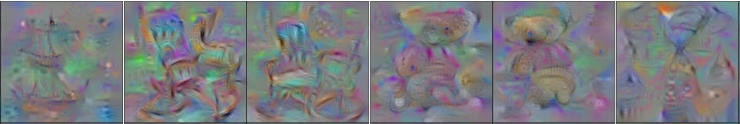
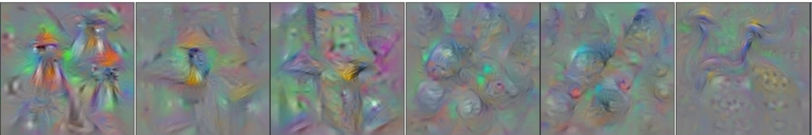
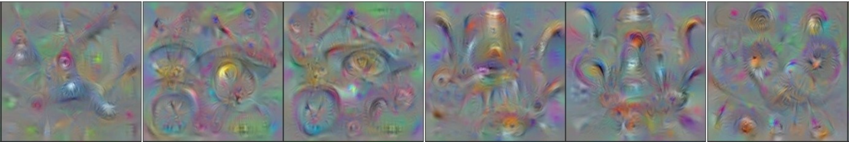
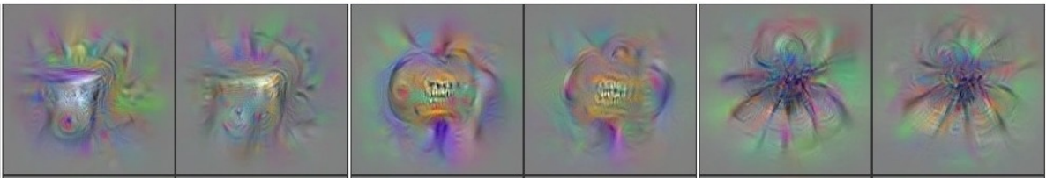
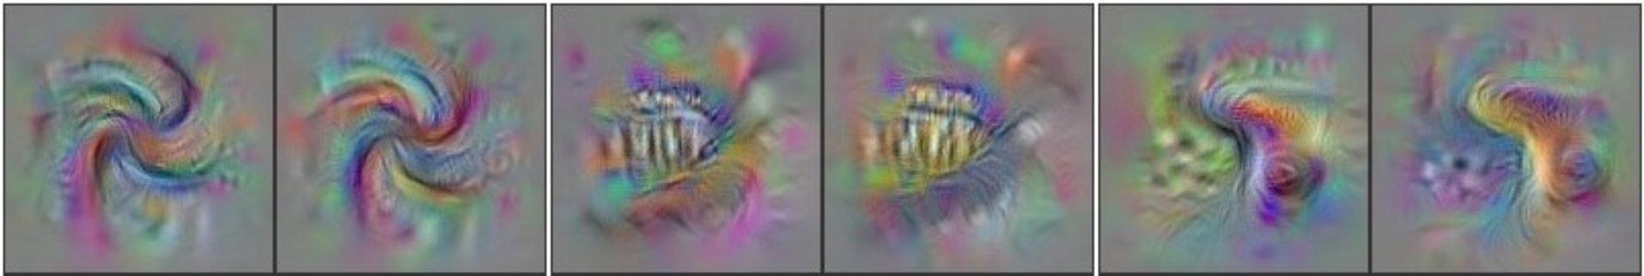
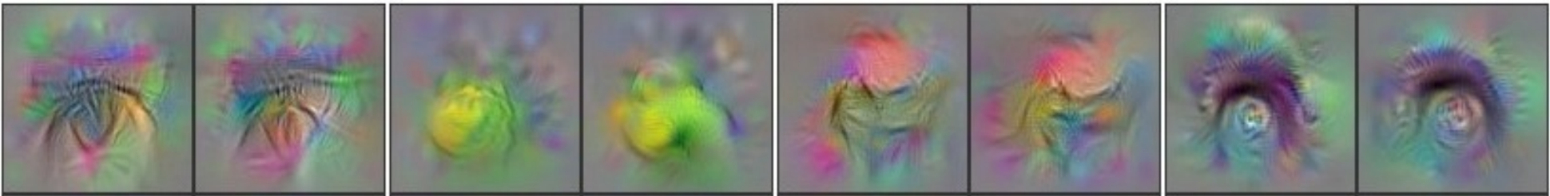
Understanding Neural Networks Through Deep Visualization. Jason Yosinski, Jeff Clune, Anh Nguyen, Thomas Fuchs, Hod Lipson

Slide 65
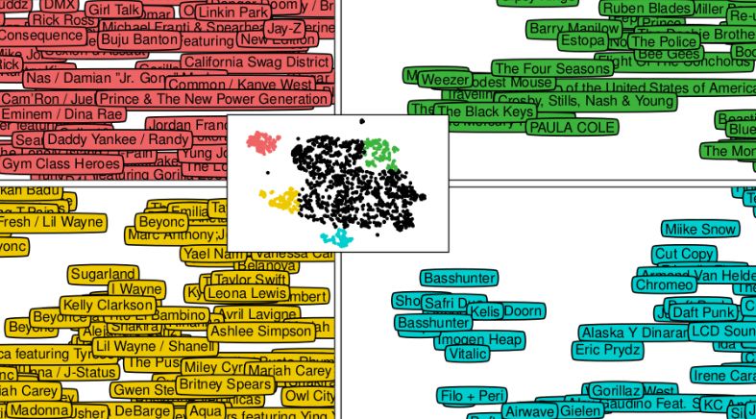
Recommending Music on Spotify with Deep Learning. Sander Dieleman

Slide 66
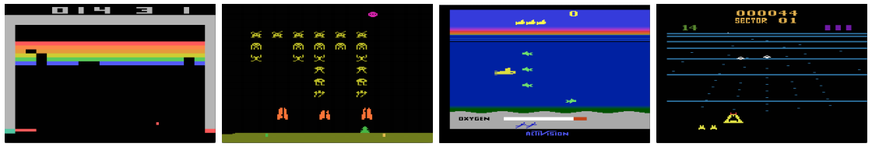
Playing Atari with Deep Reinforcement Learning. Volodymyr Mnih, Koray Kavukcuoglu, David Silver, Alex Graves, Ioannis Antonoglou, Daan Wierstra, Martin Riedmiller

Slide 67
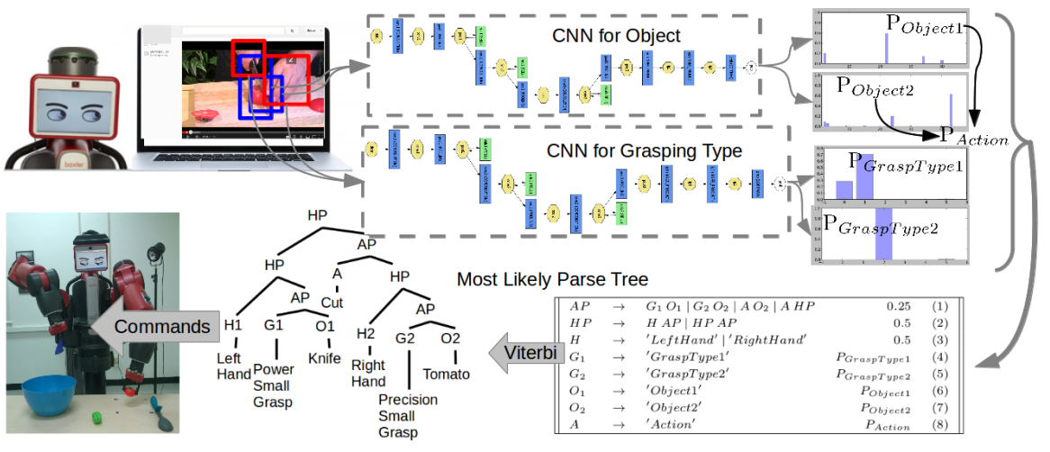
Robot Learning ManipulationAction Plans by “Watching” Unconstrained Videos from the World Wide Web. Yezhou Yang, Cornelia Fermuller, Yiannis Aloimonos

Slide 68
Deep learning BINGO
Convolutional Neural Network
Deep Belief Network
Restricted Boltzmann Machine
Deep Reinforcement Learning
Deep Q Learning
Hierarchical Temporal Memory
Stacked Denoising Autoencoders

Slide 69
Bottom line
Deep learning is good at learning patterns

Slide 70

Thanks for listening!
Thoughts to share? Questions?
Connect with me offline:
Brandon Rohrer on LinkedIn
@_brohrer_ on Twitter
brohrer@microsoft.com
Also, check out the writings of Christopher Olah

